Slide 1
The Effect of Food Delivery Platforms on the Wage Difference after Job Status Changing
Shang-Chieh Wei

Slide 2
Introduction
Research question
Is there evidence showing that the rise of food delivery platforms alleviate the income losses when workers change their job status from typical to atypical?
Why should we care?
In Taiwan, the proportion of atypical employment was about 7.13% in 2019 and this ratio is growing gradually in recent years. Also, wage differences can be generated by changing job status.
From previous research results, we have seen some evidence showing that people changing their job status from atypical to typical usually enjoy income gains while people changing from typical to atypical suffer income losses.

Slide 3
Introduction
The food delivery platforms have become extremely prevalent in Taiwan since 2019. Many people became foodpanda/Ubereats riders to earn more. The food delivery riders, however, are atypical jobs.
We’ve seen some news saying that some people earn a lot by doing jobs as food delivery riders. Can the rise of this new kind of atypical jobs help reduce income losses people suffer after changing job status or even help them enjoy income gains?

Slide 4
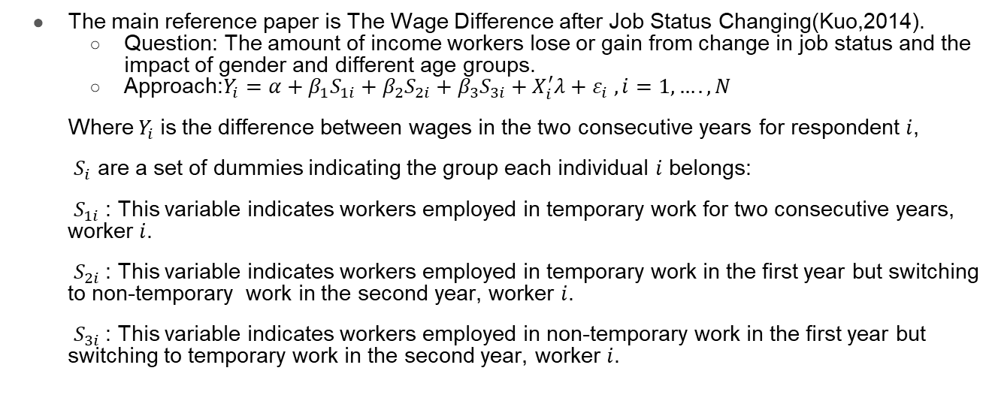
A related paper
The main reference paper is The Wage Difference after Job Status Changing(Kuo,2014).
Question: The amount of income workers lose or gain from change in job status and the impact of gender and different age groups.
Approach:$Y_{i}=α+β_{1}S_{1i}+β_{2}S_{2i}+β_{3}S_{3i}+X_{i}^{′}λ+ε_{i} ,i=1,….,N$
Where $Y_{i}$is the difference between wages in the two consecutive years for respondent $i$,
$S_{i}$ are a set of dummies indicating the group each individual $i$ belongs:
$S_{1i}$: This variable indicates workers employed in temporary work for two consecutive years, worker $i$.
$S_{2i}$: This variable indicates workers employed in temporary work in the first year but switching to non-temporary work in the second year, worker $i$.
$S_{3i}$: This variable indicates workers employed in non-temporary work in the first year but switching to temporary work in the second year, worker $i$.

Slide 5
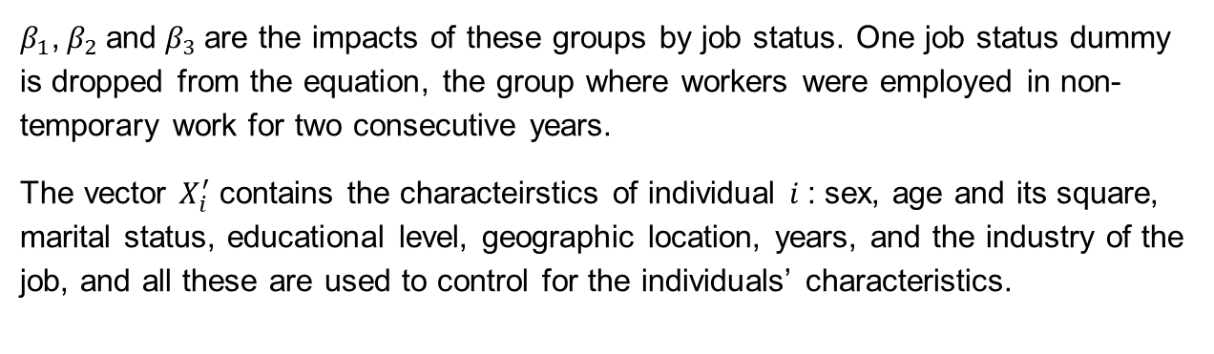
A related paper
$β_{1}$, $β_{2}$and $β_{3}$are the impacts of these groups by job status. One job status dummy is dropped from the equation, the group where workers were employed in non-temporary work for two consecutive years.
The vector $X_{i}^{′}$ contains the characteirstics of individual $i$: sex, age and its square, marital status, educational level, geographic location, years, and the industry of the job, and all these are used to control for the individuals’ characteristics.

Slide 6
A related paper
Main findings
The results suggest that on average, compared to workers having had non-temporary jobs for two consecutive years, workers who move from non-temporary jobs suffer significant income losses, about 5.8% of the average monthly income.
Workers who move from temporary to non-temporary jobs receive significant additional income, about 5.4% of the average income.

Slide 7
Data and Sample
Back to the question mentioned earlier, I want to estimate the effect of food delivery platforms on wage differences after job status changing.
This study will use the Manpower Utilization Quasi-longitudinal Survey data from the Center for Survey Research, Research Center for Humanities and Social Sciences, Academia Sinica in Taiwan. This survey is a part of the Manpower Utilization Survey, which is conducted every year since 1978.
This survey covers civilian in Taiwan who are 15 years or older in age. The data include personal information, such as gender, age, occupation and some information about job status and employment.
I will use the data from 2016 to 2019. Also, due to data limitation, I can only identify part-time workers, temporary workers and dispatched workers as atypical workers.

Slide 8
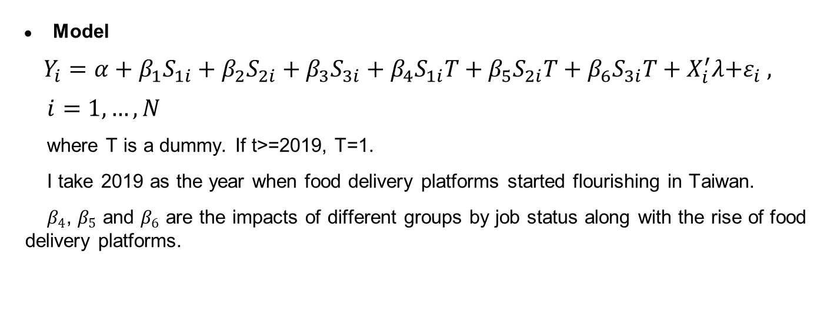
Empirical Design
Model
$$Y_{i}=α+β_{1}S_{1i}+β_{2}S_{2i}+β_{3}S_{3i}+β_{4}S_{1i}T+β_{5}S_{2i}T+β_{6}S_{3i}T+X_{i}^{′}λ{+ε}_{i} ,$$
$i=1,…,N$
where T is a dummy. If t>=2019, T=1.
I take 2019 as the year when food delivery platforms started flourishing in Taiwan.
$β_{4}$, $β_{5}$ and $β_{6}$ are the impacts of different groups by job status along with the rise of food delivery platforms.

Slide 9
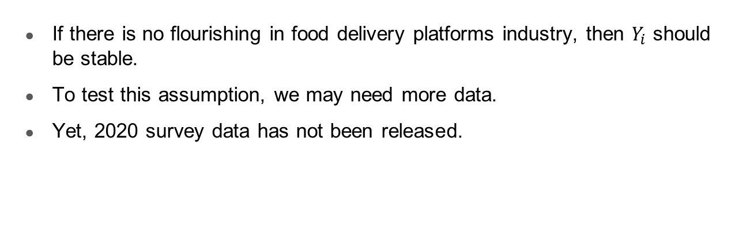
Assumptions
If there is no flourishing in food delivery platforms industry, then $Y_{i}$ should be stable.
To test this assumption, we may need more data.
Yet, 2020 survey data has not been released.

Slide 10
Thanks for listening!

